Slide 1
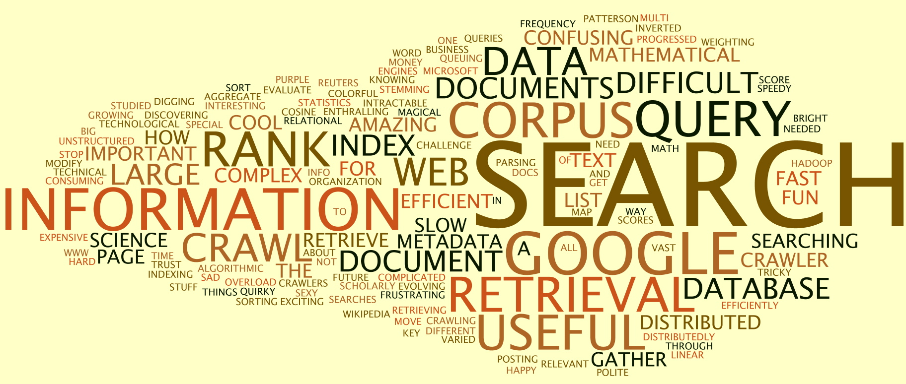

Information Retrieval
http://web.stanford.edu/class/cs276/course_schedule.html

Slide 2
Information Retrieval
Information Retrieval (IR) is finding material (usually documents) of an unstructured nature (usually text) that satisfies an information need from within large collections (usually stored on computers).
  These days we frequently think first of web search, but there are many other cases:
    E-mail search
    Searching your laptop
    Corporate knowledge bases
    Legal information retrieval
Notes:
laptop英 [ˈlæptɒp] 美 [ˈlæptɑ:p] n.便携式电脑
企业知识库
法律信息检索

Slide 3
IR vs. databases:
Structured vs unstructured data
Structured data tends to refer to information in “tables”
Employee
Manager
Salary
Smith
Jones
50000
Chang
Smith
60000
Ivy
Smith
50000
Typically allows numerical range and exact match
(for text) queries, e.g.,
Salary < 60000 AND Manager = Smith.

Slide 4
Unstructured data
Typically refers to free text
Allows
  Keyword queries including operators
  More sophisticated “concept” queries e.g.,
    find all web pages dealing with drug abuse
Classic model for searching text documents

Slide 5
Semi-structured data
In fact almost no data is “unstructured”
E.g., this slide has distinctly identified zones such as the Title and Bullets
    … to say nothing of linguistic structure
Facilitates “semi-structured” search such as
  Title contains data AND Bullets contain search
Or even
  Title is about Object Oriented Programming AND Author something like stro*rup
  where * is the wild-card operator

Slide 6
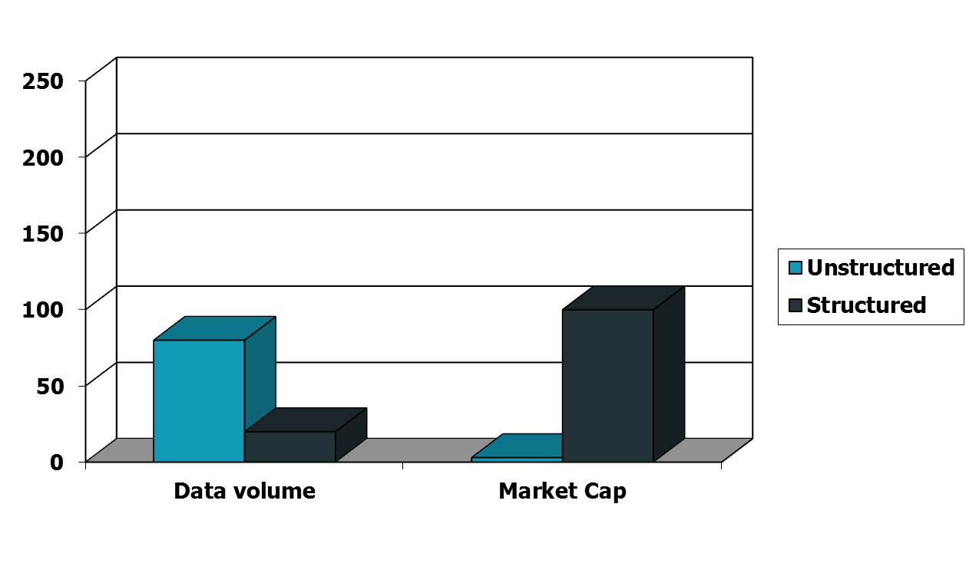
Unstructured (text) vs. structured (database) data in the mid-nineties

Slide 7
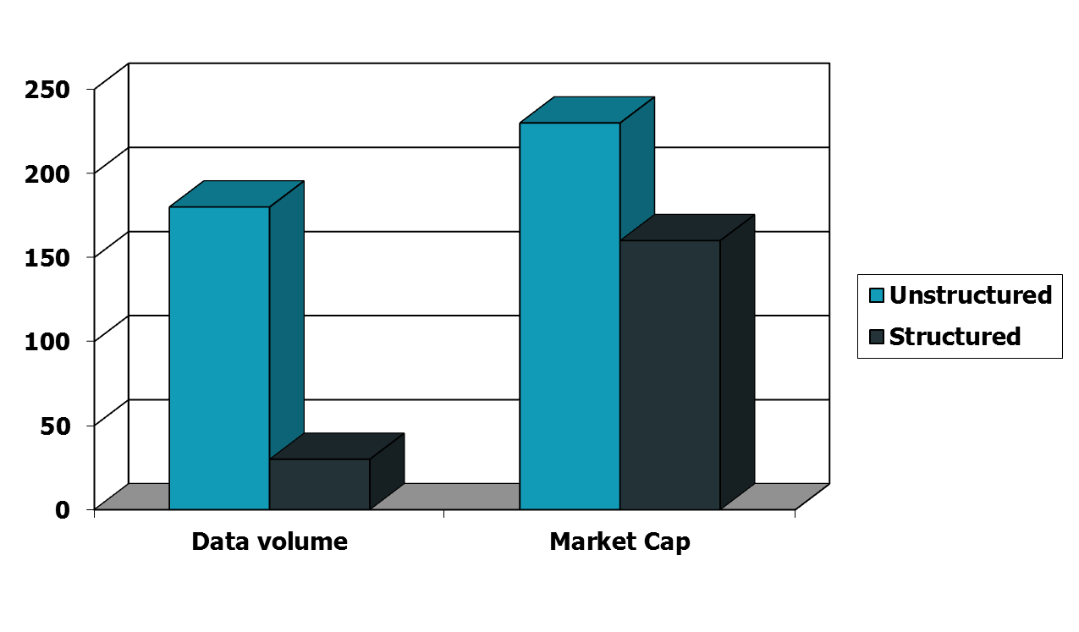
Unstructured (text) vs. structured (database) data in 2009
Notes:
To the surprise of many, the search box has become the preferred method of information access.
Customers ask: Why can’t I search my database in the same way?

Slide 8
Basic assumptions of Information Retrieval
Sec. 1.1
Collection: A set of documents
  Assume it is a static collection for the moment
Goal: Retrieve documents with information that is relevant to the user’s information need and helps the user complete a task

Slide 9
The classic search model
User task
Get rid of mice in a politically correct way
Misconception?
Info need
Info about removing mice
without killing them
Misformulation?
Query
how trap mice alive
Search
Search
engine
Query
refinement
Results
Collection
Notes:
Misconception 英 [ˌmɪskənˈsepʃn] 美 [ˌmɪskənˈsɛpʃən] n.误解;错觉;错误想法

Slide 10
How good are the retrieved docs?
Sec. 1.1
Precision : Fraction of retrieved docs that are relevant to the user’s information need
Recall : Fraction of relevant docs in collection that are retrieved
  More precise definitions and measurements to follow later

Slide 11
Term-document incidence matrices
词项-文档关联矩阵

Slide 12
Unstructured data in 1620
Sec. 1.1
Which plays of Shakespeare contain the words Brutus AND Caesar but NOT Calpurnia?
One could linear scan through all of Shakespeare’s plays for Brutus and Caesar, then strip out lines containing Calpurnia?
Why is that not the answer?
  Slow (for large corpora)
  Other operations (e.g., find the word Romans near countrymen) not feasible
  Ranked retrieval (best documents to return)
    Later lectures
Notes:
Grep(linear scan through) is line-oriented; IR is document oriented.
Brutus 布鲁图斯；
Caesar 凯撒；
Calpurnia 卡尔普尼亚；

Slide 13
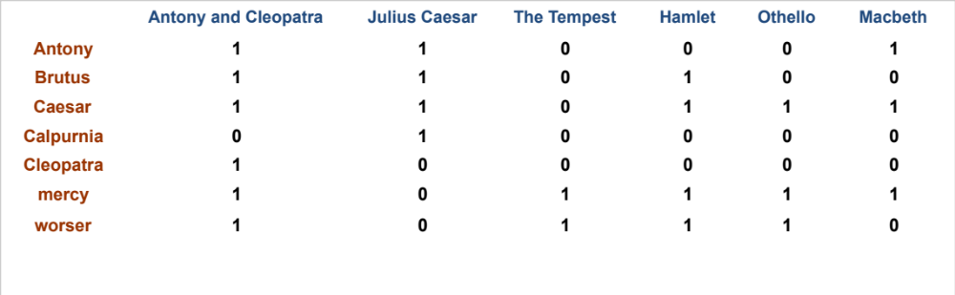
Term-document incidence matrices
Sec. 1.1
1 if play contains word, 0 otherwise
Brutus AND Caesar BUT NOT Calpurnia
Notes:
Antony and Cleopatran.安东尼与克里奥佩特拉
Julius Caesar 尤利乌斯•凯撒
The Tempest 暴风雨
《安东尼与克莉奥佩特拉》是莎士比亚于1607年左右编写的罗马悲剧，它是源于古罗马历史学家普鲁塔克的《希腊罗马名人传》。
戏剧讲述的是当时罗马的三大首领之一：安东尼因沉迷于埃及女王克莉奥佩特拉的美色而无暇于国家大事，终日与她在埃及厮混，天天醉生梦死。后来，罗马受到塞克斯特斯·庞贝的叛乱，海盗的入侵，东方帕提亚人的人侵以及安东尼妻子因向凯撒挑战失败而死的消息终于让他重新振作起来，毅然回到罗马，为祖国效力。安东尼遂因形势需要与屋大维和好，并娶其妹来巩固彼此的政治关系。这也让克莉奥佩特拉又伤心又愤怒。终于，各种战事和解消停后，安东尼迫不及待的回到了埃及女王身边。后来庞贝被杀，同僚莱皮德斯被废黜导致了最后安东尼和屋大维的两虎对峙。在海上对战中，安东尼不明智地跟随埃及女王逃跑而战败，最终伤心自刎，克莉奥佩特拉也终于看清屋大维的真面目，自杀身亡。

Slide 14
Incidence vectors
Sec. 1.1
So we have a 0/1 vector for each term.
To answer query: take the vectors for Brutus, Caesar and Calpurnia (complemented) ➔ bitwise AND.
  110100 AND
  110111 AND
  101111 =
  100100

Slide 15
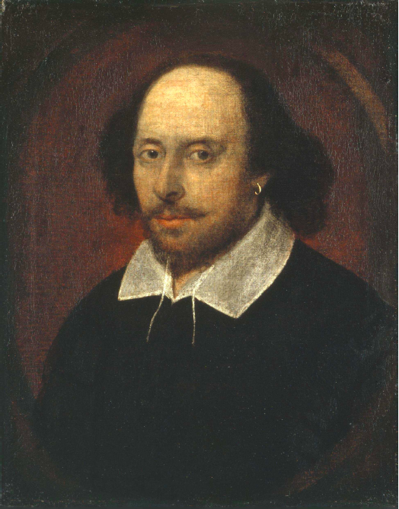
Answers to query
Sec. 1.1
Antony and Cleopatra, Act III, Scene ii
Agrippa [Aside to DOMITIUS ENOBARBUS]: Why, Enobarbus,
When Antony found Julius Caesar dead,
He cried almost to roaring; and he wept
When at Philippi he found Brutus slain.
Hamlet, Act III, Scene ii
Lord Polonius: I did enact Julius Caesar I was killed i’ the
Capitol; Brutus killed me.

Slide 16
Bigger collections
Sec. 1.1
Consider N = 1 million documents, each with about 1000 words.
Avg 6 bytes/word including spaces/punctuation
  6GB of data in the documents.
Say there are M = 500K distinct terms among these.

Slide 17
Can’t build the matrix
Sec. 1.1
500K x 1M matrix has half-a-trillion 0’s and 1’s.
But it has no more than one billion 1’s.
  matrix is extremely sparse.
What’s a better representation?
  We only record the 1 positions.
Why?

Slide 18
The Inverted Index
The key data structure underlying modern IR

Slide 19
Inverted index
Sec. 1.2
For each term t, we must store a list of all documents that contain t.
  Identify each doc by a docID, a document serial number
Can we used fixed-size arrays for this?
Brutus
1
2
4
11
31
45
173
174
Caesar
1
2
4
5
6
16
57
132
Calpurnia
2
31
54
101
What happens if the word Caesar is added to document 14?

Slide 20
Inverted index
Sec. 1.2
We need variable-size postings lists
  On disk, a continuous run of postings is normal and best
  In memory, can use linked lists or variable length arrays
    Some tradeoffs in size/ease of insertion
Posting
Brutus
1
2
4
11
31
45
173
174
Caesar
1
2
4
5
6
16
57
132
Calpurnia
2
31
54
101
Dictionary
Postings
Sorted by docID (more later on why).
Notes:
Linked lists generally preferred to arrays
Dynamic space allocation
Insertion of terms into documents easy
Space overhead of pointers

Slide 21

Inverted index construction
Sec. 1.2
Documents to
be indexed
Friends, Romans, countrymen.
Tokenizer
Token stream
Friends
Romans
Countrymen
Linguistic modules
Modified tokens
friend
roman
countryman
Indexer
friend
2
4
roman
1
2
Inverted index
countryman
13
16
Notes:
Document icons from free icon set: http://www.icojoy.com/articles/44/

Slide 22
Initial stages of text processing
Tokenization
  Cut character sequence into word tokens
    Deal with “John’s”, a state-of-the-art solution
Normalization
  Map text and query term to same form
    You want U.S.A. and USA to match
Stemming
  We may wish different forms of a root to match
    authorize, authorization
Stop words
  We may omit very common words (or not)
    the, a, to, of
Notes:
normalization英 [ˌnɔ:məlaɪ'zeɪʃn] 美 [ˌnɔ:məlaɪ'zeɪʃn] n.正常化;标准化;正态化

Slide 23

Indexer steps: Token sequence
Sec. 1.2
Sequence of (Modified token, Document ID) pairs.
Doc 1
Doc 2
I did enact Julius
Caesar I was killed
i’ the Capitol;
Brutus killed me.
So let it be with
Caesar. The noble
Brutus hath told you
Caesar was ambitious

Slide 24

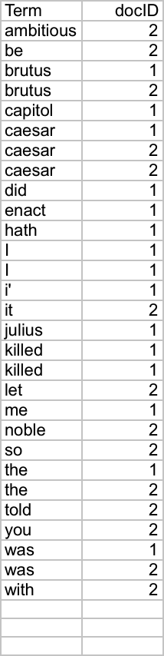
Indexer steps: Sort
Sec. 1.2
Sort by terms
  And then docID
Core indexing step

Slide 25

Indexer steps: Dictionary & Postings
Sec. 1.2
Multiple term entries in a single document are merged.
Split into Dictionary and Postings
Doc. frequency information is added.
Why frequency?
Will discuss later.

Slide 26
Where do we pay in storage?
Sec. 1.2
Lists of docIDs
Terms and counts
IR system implementation
How do we index efficiently?
How much storage do we need?
Pointers

Slide 27
Query processing with an inverted index

Slide 28
The index we just built
Sec. 1.3
How do we process a query?
  Later - what kinds of queries can we process?
Our focus

Slide 29
Query processing: AND
Sec. 1.3
Consider processing the query:
  Brutus AND Caesar
  Locate Brutus in the Dictionary;
    Retrieve its postings.
  Locate Caesar in the Dictionary;
    Retrieve its postings.
  “Merge” the two postings (intersect the document sets):
2
4
8
16
32
64
128
Brutus
1
2
3
5
8
13
21
34
Caesar

Slide 30
The merge
Sec. 1.3
Walk through the two postings simultaneously, in time linear in the total number of postings entries
2
4
8
16
32
64
128
Brutus
1
2
3
5
8
13
21
34
Caesar
If the list lengths are x and y, the merge takes O(x+y)
operations.
Crucial: postings sorted by docID.

Slide 31

Intersecting two postings lists
(a “merge” algorithm)

Slide 32
The Boolean Retrieval Model
& Extended Boolean Models

Slide 33
Boolean queries: Exact match
Sec. 1.3
The Boolean retrieval model is being able to ask a query that is a Boolean expression:
  Boolean Queries are queries using AND, OR and NOT to join query terms
    Views each document as a set of words
    Is precise: document matches condition or not.
  Perhaps the simplest model to build an IR system on
Primary commercial retrieval tool for 3 decades.
Many search systems you still use are Boolean:
  Email, library catalog, desktop search

Slide 34
Boolean queries: More general merges
Sec. 1.3
Exercise: Adapt the merge for the queries:
  NOT Caesar
  Brutus AND NOT Caesar
  Brutus OR NOT Caesar
Can we still run through the merge in time O(x+y)? What can we achieve?
2
4
8
16
32
64
128
Brutus
1
2
3
5
8
13
21
34
Caesar
Notes:
a. Brutus AND NOT Caesar
b. Brutus OR NOT Caesar
SOLUTION. a. Time is O(x+y). Instead of collecting documents that occur in both postings lists, collect those that occur in the first one and not in
the second. b. Time is O(N) (where N is the total number of documents in the
collection) assuming we need to return a complete list of all documents satisfying the query. This is because the length of the results list is only bounded
by N, not by the length of the postings lists.

Slide 35
Merging
Sec. 1.3
What about an arbitrary Boolean formula?
(Brutus OR Caesar) AND NOT
(Antony OR Cleopatra)
Can we always merge in “linear” time?
  Linear in what?
Can we do better?
2
4
8
16
32
64
128
Brutus
1
2
3
5
8
13
21
34
Caesar
Notes:
Extend the postings merge algorithm to arbitrary Boolean query formulas. What is
its time complexity? For instance, consider:
c. (Brutus OR Caesar) AND NOT (Anthony OR Cleopatra)
Can we always merge in linear time? Linear in what? Can we do better than this?
SOLUTION. We can always intersect in O(qN) where q is the number
of query terms and N the number of documents, so the intersection time is
linear in the number of documents and query terms. Since the tightest bound
for the size of the results list is N, the number of documents, you cannot do
better than O(N)

Slide 36
Query optimization
Sec. 1.3
What is the best order for query processing?
Consider a query that is an AND of n terms.
For each of the n terms, get its postings, then AND them together.
Brutus
2
4
8
16
32
64
128
Caesar
1
2
3
5
8
16
21
34
Calpurnia
13
16
Query: Brutus AND Calpurnia AND Caesar

Slide 37
Query optimization example
Sec. 1.3
Process in order of increasing freq:
  start with smallest set, then keep cutting further.
This is why we kept
document freq. in dictionary
Brutus
2
4
8
16
32
64
128
Caesar
1
2
3
5
8
16
21
34
Calpurnia
13
16
Execute the query as (Calpurnia AND Brutus) AND Caesar.

Slide 38
More general optimization
Sec. 1.3
e.g., (madding OR crowd) AND (ignoble OR strife)
Get doc. freq.’s for all terms.
Estimate the size of each OR by the sum of its doc. freq.’s (conservative).
Process in increasing order of OR sizes.

Slide 39
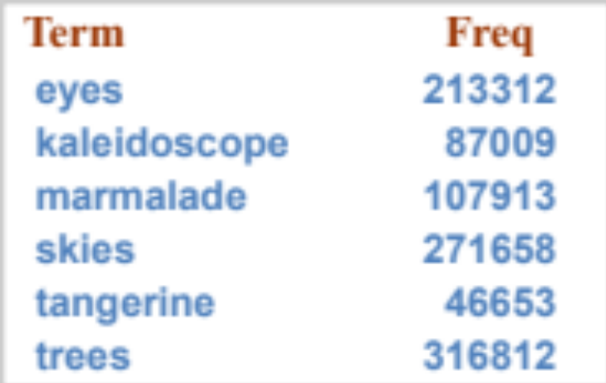
Exercise
Recommend a query processing order for
Which two terms should we process first?
(tangerine OR trees) AND
(marmalade OR skies) AND
(kaleidoscope OR eyes)

Slide 40
Dictionary data structures

Slide 41
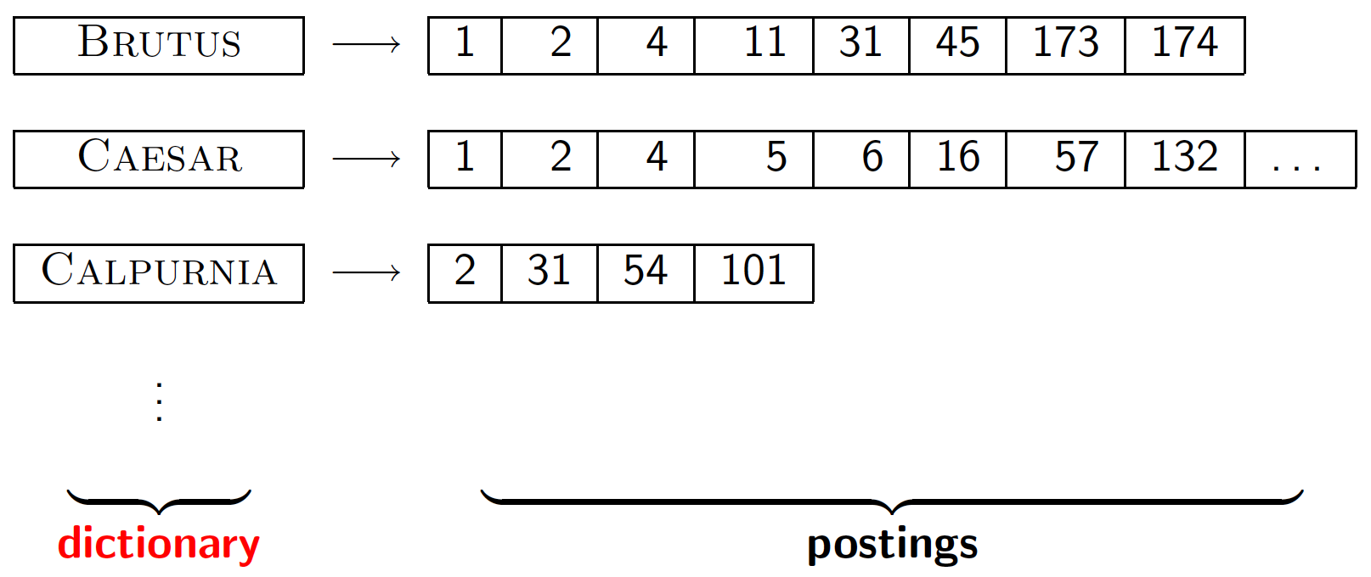
Dictionary data structures for inverted indexes
Sec. 3.1
The dictionary data structure stores the term vocabulary, document frequency, pointers to each postings list … in what data structure?

Slide 42
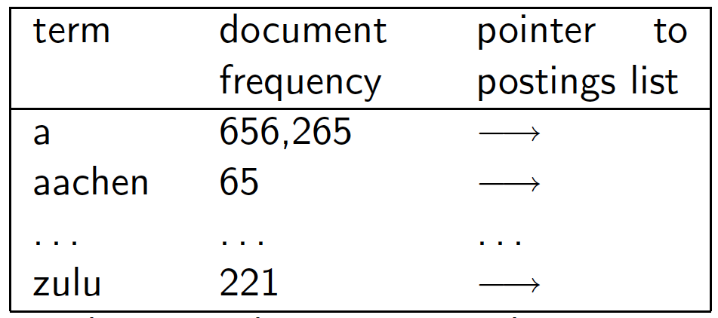
A naïve dictionary
Sec. 3.1
An array of struct:
char[20] int Postings *
20 bytes 4/8 bytes 4/8 bytes
How do we store a dictionary in memory efficiently?
How do we quickly look up elements at query time?

Slide 43
Dictionary data structures
Sec. 3.1
Two main choices:
  Hashtables
  Trees
Some IR systems use hashtables, some trees

Slide 44
Hashtables
Sec. 3.1
Each vocabulary term is hashed to an integer
  (We assume you’ve seen hashtables before)
Pros:
  Lookup is faster than for a tree: O(1)
Cons:
  No easy way to find minor variants:
    judgment/judgement
  No prefix search [tolerant retrieval]
  If vocabulary keeps growing, need to occasionally do the expensive operation of rehashing everything
Notes:
judgment英 ['dʒʌdʒmənt] 美 [ˈdʒʌdʒmənt] n.判断，鉴定;辨别力，判断力;意见，看法;判决书

Slide 45
Tree: binary tree
Sec. 3.1
Root
a-m
n-z
a-hu
hy-m
n-sh
si-z
huygens
sickle
zygot
aardvark
Notes:
https://www.cnblogs.com/suimeng/p/4560056.html
平衡二叉查找树：简称平衡二叉树。由前苏联的数学家Adelse-Velskil和Landis在1962年提出的高度平衡的二叉树，根据科学家的英文名也称为AVL树。它具有如下几个性质：
可以是空树。
假如不是空树，任何一个结点的左子树与右子树都是平衡二叉树，并且高度之差的绝对值不超过1
平衡之意，如天平，即两边的分量大约相同。如定义，假如一棵树的左右子树的高度之差超过1，如左子树的树高为2，右子树的树高为0，子树树高差的绝对值为2就打破了这个平衡。

Slide 46
Tree: B-tree
Sec. 3.1
a-hu
n-z
hy-m
  Definition: Every internal nodel has a number of children in the interval [a,b] where a, b are appropriate natural numbers, e.g., [2,4].

Slide 47
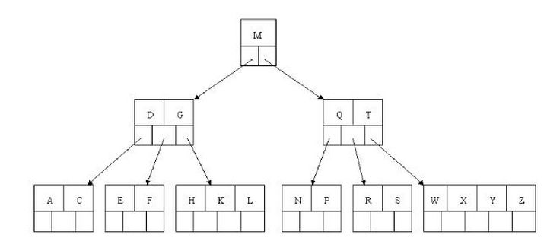
Tree: B-tree

Slide 48
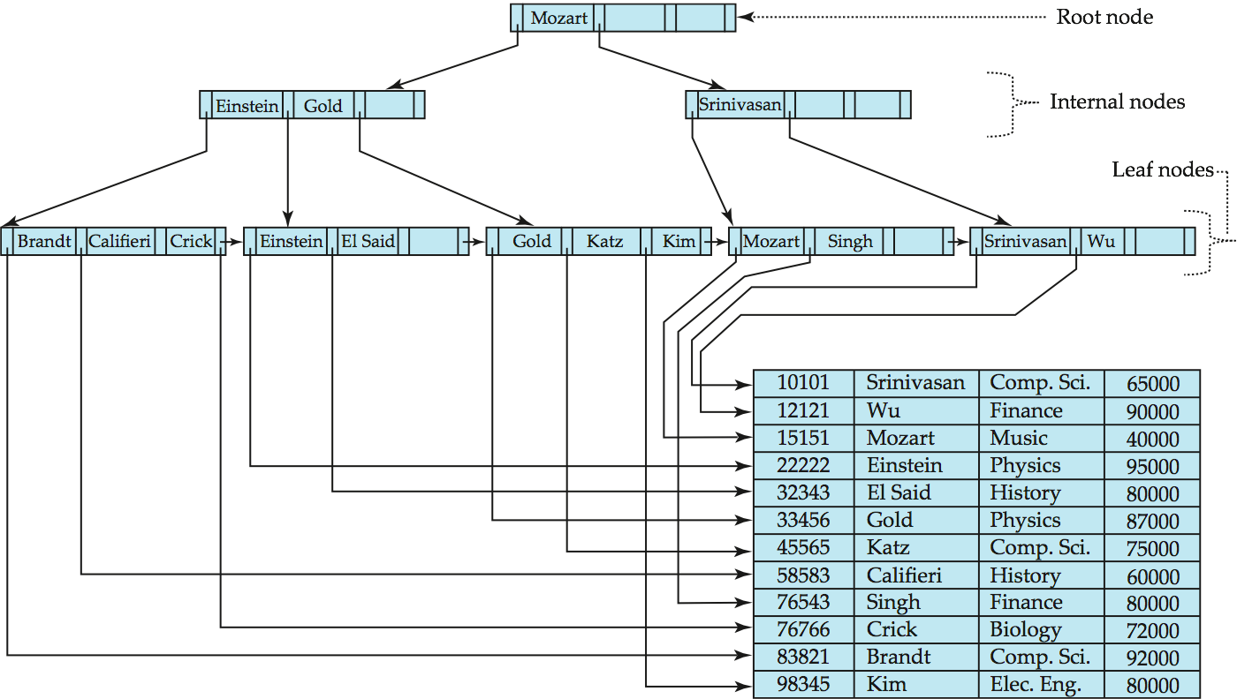
Example: B⁺-Tree of Database Systems

Slide 49
Trees
Sec. 3.1
Simplest: binary tree
More usual: B-trees
Trees require a standard ordering of characters and hence strings … but we typically have one
Pros:
  Solves the prefix problem (terms starting with hyp)
Cons:
  Slower: O(log M) [and this requires balanced tree]
  Rebalancing binary trees is expensive
    But B-trees mitigate the rebalancing problem

Slide 50
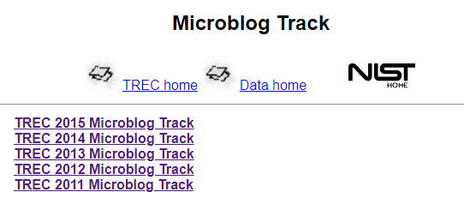
Homework3: Inverted index and Boolean Retrieval Model
Deadline: 2018.11.4 23:00
https://trec.nist.gov/data/microblog.html

Slide 51
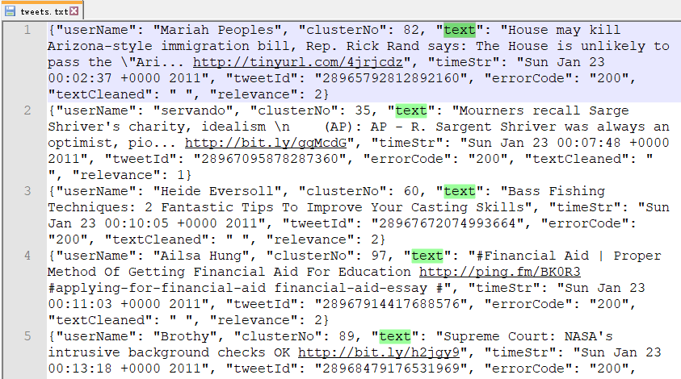
Homework3: Inverted index and Boolean Retrieval Model
30548条tweets，用于创建inverted index

Slide 52
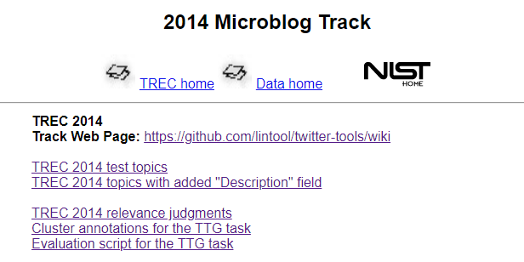
Homework3: Inverted index and Boolean Retrieval Model
Deadline: 2018.11.4 23:00
https://trec.nist.gov/data/microblog2014.html

Slide 53
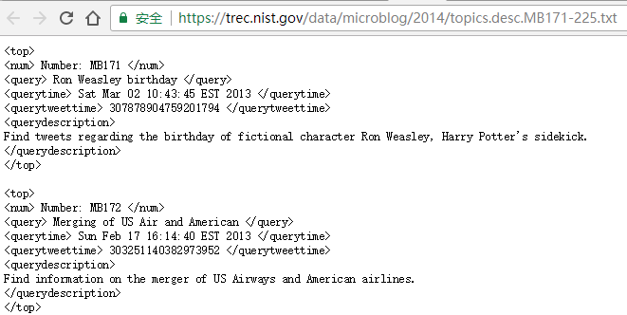
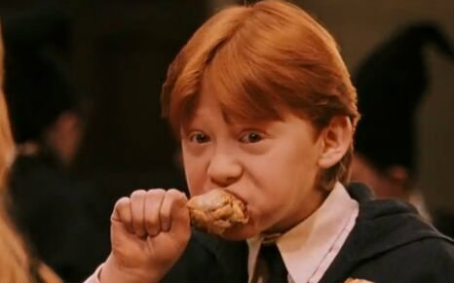
Homework3: Inverted index and Boolean Retrieval Model
TREC 2014 topics with added "Description" field
Query: Ron Weasley birthday
55个queries，用于测试Boolean Retrieval Model

Slide 54
Homework3: Inverted index and Boolean Retrieval Model
任务：
  使用我们介绍的方法，在tweets数据集上构建inverted index;
  实现Boolean Retrieval Model，使用TREC 2014 test topics进行测试；
  Boolean Retrieval Model：
    Input：a query (like Ron Weasley birthday)
    Output: print a list of top k relevant tweets.
    支持and, or ,not；查询优化可以选做；
注意：
  对于tweets与queries使用相同的预处理；

Slide 55
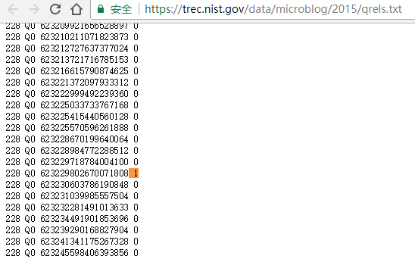
Homework3: Inverted index and Boolean Retrieval Model
Judgment file
Deadline: 2018.11.4 23:00

Slide 56
Query processing exercises
Exercise: If the query is friends AND romans AND (NOT countrymen), how could we use the freq of countrymen?
Exercise: Extend the merge to an arbitrary Boolean query. Can we always guarantee execution in time linear in the total postings size?
Hint: Begin with the case of a Boolean formula query: in this, each query term appears only once in the query.
Notes:
If the query is:e. friends AND romans AND (NOT countrymen)
how could we use the frequency of countrymen in evaluating the best query evaluation
order? In particular, propose a way of handling negation in determining the order of
query processing.
SOLUTION. For very frequent negated terms, use N-(length of postings
list) instead of (length of postings list). For infrequent negated terms, use
(length of postings list) for ordering. Process the latter group last. (Need to
say what to do with very frequent non-negated terms.)

Slide 57
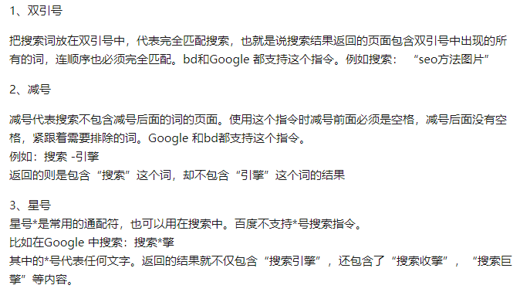
如何用好谷歌等搜索引擎？

Slide 58
Phrase queries and positional indexes

Slide 59
Phrase queries
Sec. 2.4
We want to be able to answer queries such as “stanford university” – as a phrase
Thus the sentence “I went to university at Stanford” is not a match.
  The concept of phrase queries has proven easily understood by users; one of the few “advanced search” ideas that works
  Many more queries are implicit phrase queries
For this, it no longer suffices to store only
<term : docs> entries

Slide 60
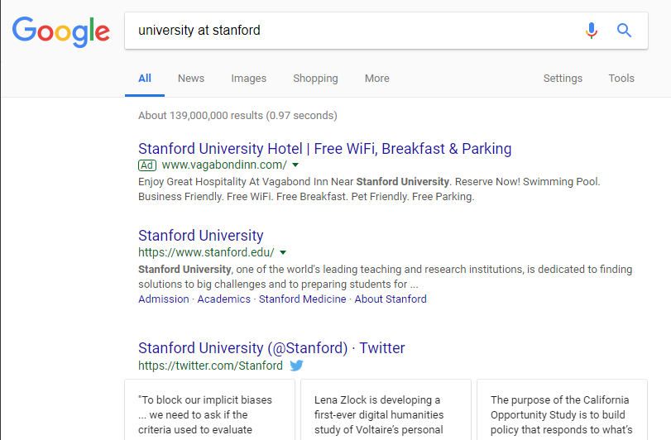
Phrase queries: example

Slide 61

Phrase queries: example

Slide 62
A first attempt: Biword indexes
Sec. 2.4.1
Index every consecutive pair of terms in the text as a phrase
For example the text “Friends, Romans, Countrymen” would generate the biwords
  friends romans
  romans countrymen
Each of these biwords is now a dictionary term
Two-word phrase query-processing is now immediate.

Slide 63
Longer phrase queries
Sec. 2.4.1
Longer phrases can be processed by breaking them down
stanford university palo alto can be broken into the Boolean query on biwords:
stanford university AND university palo AND palo alto
Without the docs, we cannot verify that the docs matching the above Boolean query do contain the phrase.
Can have false positives!
Notes:
Palo Alton.帕罗奥图（市），美国加利福尼亚州;[地名] [巴拿马、古巴、美国、墨西哥、尼加拉瓜] 帕洛阿尔托

Slide 64
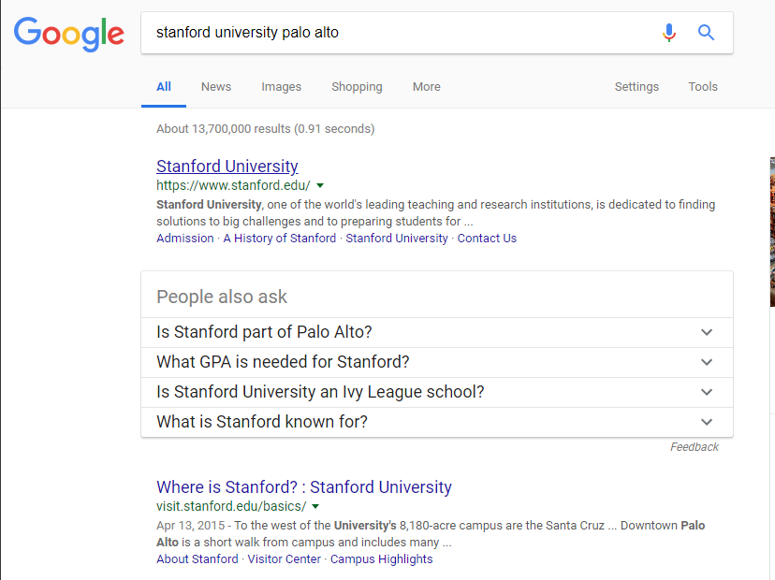
Phrase queries: example

Slide 65
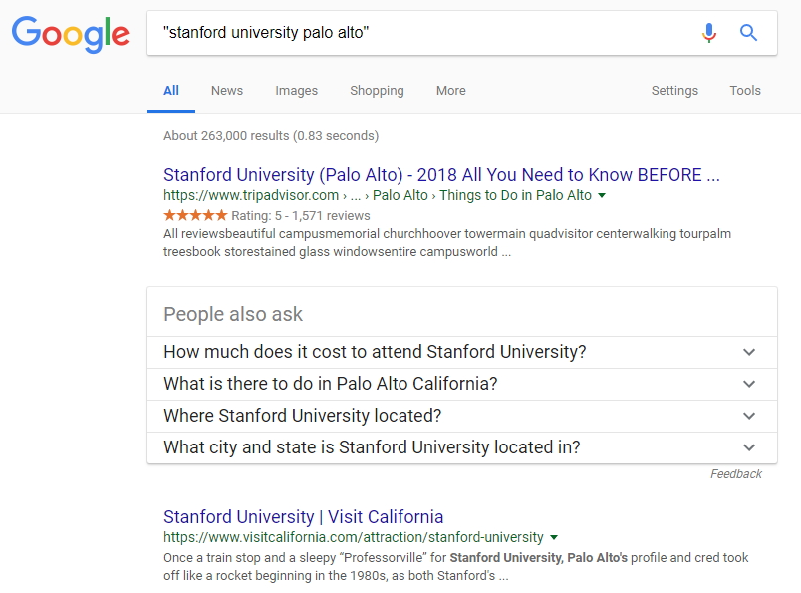
Phrase queries: example

Slide 66
Issues for biword indexes
Sec. 2.4.1
False positives, as noted before
Index blowup due to bigger dictionary
  Infeasible for more than biwords, big even for them
Biword indexes are not the standard solution (for all biwords) but can be part of a compound strategy
Notes:
Michael Jackson
对于常用的查询，建立biword indexes

Slide 67
Solution 2: Positional indexes
Sec. 2.4.2
In the postings, store, for each term the position(s) in which tokens of it appear:
  <term, number of docs containing term;
  doc1: position1, position2 … ;
  doc2: position1, position2 … ;
  etc.>

Slide 68
Positional index example
Sec. 2.4.2
<be: 993427;
1: 7, 18, 33, 72, 86, 231;
2: 3, 149;
4: 17, 191, 291, 430, 434;
5: 363, 367, …>
Which of docs 1,2,4,5
could contain “to be
or not to be”?
For phrase queries, we use a merge algorithm recursively at the document level
But we now need to deal with more than just equality

Slide 69
Processing a phrase query
Sec. 2.4.2
Extract inverted index entries for each distinct term: to, be, or, not.
Merge their doc:position lists to enumerate all positions with “to be or not to be”.
  to:
    2:1,17,74,222,551; 4:8,16,190,429,433; 7:13,23,191; ...
  be:
    1:17,19; 4:17,191,291,430,434; 5:14,19,101; ...
Same general method for proximity searches

Slide 70
Proximity queries
Sec. 2.4.2
federal /2 tort
  Again, here, /k means “within k words of”.
Clearly, positional indexes can be used for such queries; biword indexes cannot.
Exercise: Adapt the linear merge of postings to handle proximity queries. Can you make it work for any value of k?
  This is a little tricky to do correctly and efficiently
  See Figure 2.12 of IIR
Notes:
联邦
侵权

Slide 71
Positional index size
Sec. 2.4.2
A positional index expands postings storage substantially
  Even though indices can be compressed
Nevertheless, a positional index is now standardly used because of the power and usefulness of phrase and proximity queries … whether used explicitly or implicitly in a ranking retrieval system.

Slide 72
Positional index size
Sec. 2.4.2
Need an entry for each occurrence, not just once per document
Index size depends on average document size
  Average web page has <1000 terms
  SEC filings, books, even some epic poems … easily 100,000 terms
Consider a term with frequency 0.1%
Why?
Document size
Postings
Positional postings
1000
1
1
100,000
1
100

Slide 73
Rules of thumb
Sec. 2.4.2
A positional index is 2–4 as large as a non-positional index
Positional index size 35–50% of volume of original text
  Caveat: all of this holds for “English-like” languages

Slide 74
Combination schemes
Sec. 2.4.3
These two approaches can be profitably combined
  For particular phrases (“Michael Jackson”, “Britney Spears”) it is inefficient to keep on merging positional postings lists
    Even more so for phrases like “The Who”
Williams et al. (2004) evaluate a more sophisticated mixed indexing scheme
  A typical web query mixture was executed in ¼ of the time of using just a positional index
  It required 26% more space than having a positional index alone

Slide 75
Faster postings merges:
Skip pointers/Skip lists

Slide 76
Recall basic merge
Sec. 2.3
Walk through the two postings simultaneously, in time linear in the total number of postings entries
2
4
8
41
48
64
128
Brutus
2
8
1
2
3
8
11
17
21
31
Caesar
If the list lengths are m and n, the merge takes O(m+n)
operations.
Can we do better?
Yes (if the index isn’t changing too fast).

Slide 77
Augment postings with skip pointers (at indexing time)
Sec. 2.3
41
128
2
4
8
41
48
64
128
11
31
1
2
3
8
11
17
21
31
Why?
To skip postings that will not figure in the search results.
How?
Where do we place skip pointers?

Slide 78
Query processing with skip pointers
Sec. 2.3
41
128
2
4
8
41
48
64
128
11
31
1
2
3
8
11
17
21
31
Suppose we’ve stepped through the lists until we process 8 on each list. We match it and advance.
We then have 41 and 11 on the lower. 11 is smaller.
But the skip successor of 11 on the lower list is 31, so
we can skip ahead past the intervening postings.

Slide 79
Where do we place skips?
Sec. 2.3
Tradeoff:
  More skips → shorter skip spans ⇒ more likely to skip. But lots of comparisons to skip pointers.
  Fewer skips → few pointer comparison, but then long skip spans ⇒ few successful skips.

Slide 80
Placing skips
Sec. 2.3
Simple heuristic: for postings of length L, use √L evenly-spaced skip pointers [Moffat and Zobel 1996]
This ignores the distribution of query terms.
Easy if the index is relatively static; harder if L keeps changing because of updates.
This definitely used to help; with modern hardware it may not unless you’re memory-based [Bahle et al. 2002]
  The I/O cost of loading a bigger postings list can outweigh the gains from quicker in memory merging!

